Slide 1
Twitter Sentiment Analysis: has sentiment towards TRUMP shifted after election?
Bloomiya Kurian
Foundations of Data Science Workshop
May 2017

Slide 2
The Problem
Soon after Trump became President his Policies and Views changed the tone of national conversation
Executive Orders such as immigration ban, travel ban, Muslim ban etc. sparked debate on both sides of the aisle
Identify if the supporters who voted for Trump also supported his policies or has the sentiment shifted after election

Slide 3
THE Approach
Collect tweets containing hashtags* and search terms (‘immigrationban’, ‘travelban’, ‘muslimban’, ‘BanIslam’, ‘resist’, ‘DeleteUber’, ‘IResist’, ‘TheResistance’) for each state in US
Clean-up tweet texts and calculate a polarity level (-1 to +1) sentiment score for each text
Aggregate (mean) sentiment score on State level
*These search terms and hashtags were selected based on the major actions (executive orders on travel ban, immigration etc.) President Trump implemented immediately after becoming the President. Some articles such as this one listed the most common hashtags people used to tweet their opinions about President Trump.

Slide 4
THE Approach (2)
Visualize sentiment polarity on US map and compare state wise support and resistance to Trump
Statistically prove if there is a relationship between voting trend and sentiment after election across the US states

Slide 5
Data Extraction
Used Twitter Rest API
‘searchTwitter’ R function
Search query with search terms, geocodes and radius was executed for main cities of all US states except Idaho
Results of all the queries were consolidated, deduped and saved to a .csv file

Slide 6
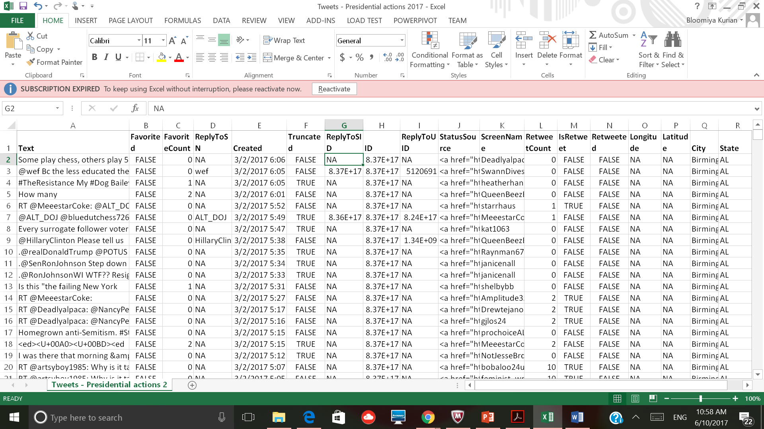
Data Set

Slide 7
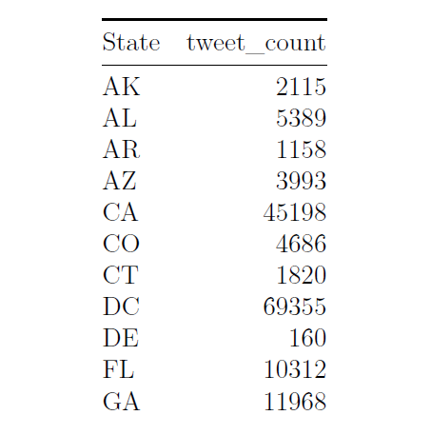
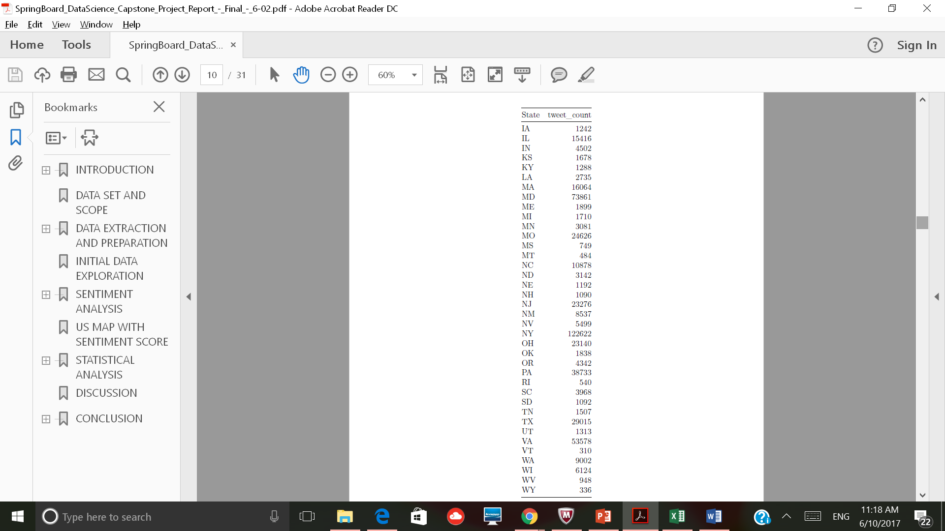
Initial data exploration
Total Data Count : 65,7511
State with minimum number of tweets: Delaware
State with maximum number of tweets: New York
Missing State: Idaho
Varying count of tweets per State -> Uneven population

Slide 8
Sentiment Score
Sentiment Classification Package: ‘sentimentr’
Calculated sentiment on sentence level rather than counting number of negative and positive words in the sentence
Score was generated for texts ‘with’ and ‘without’ hashtags
Correlation Analysis between the two scores showed a strong positive association with a coefficient of 0.8766415

Slide 9
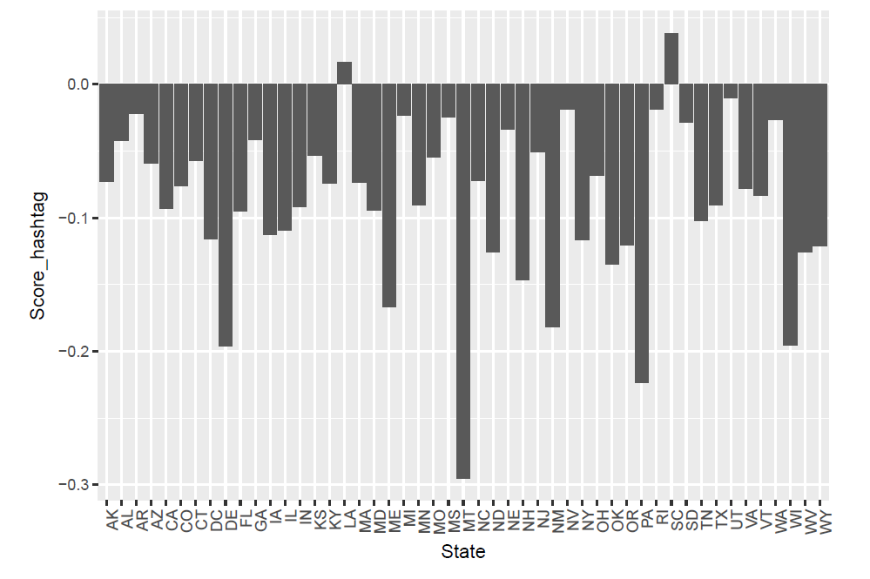
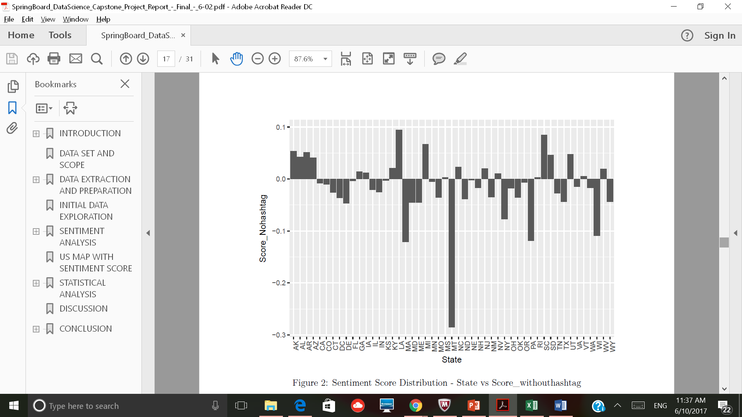
Sentiment score distribution
Texts without hashtag gave similar number of positive (supporting) and negative (resisting) scores
Texts with hashtag gave negative scores for all states except two
Hence scores generated by texts without hashtag were selected to perform further analysis
Distribution with hashtag
Distribution without hashtag

Slide 10
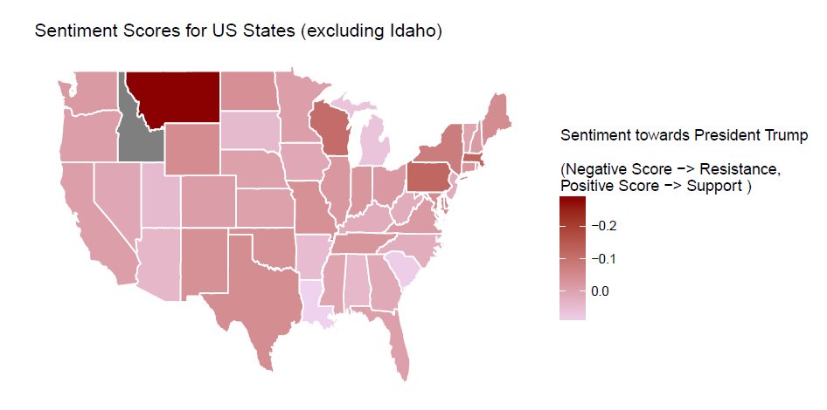
US MAP with Sentiment Score
Mean score for all States except Idaho

Slide 11
Statistical Analysis
Sentiment score and popular vote election results for each state were compared to identify if there is a relation between a state’s people’s voting trend and their sentiment towards the president’s actions post election
Trump’s Victory Margin for each state was used as election results
Victory Margin: Difference between total number of votes received by a candidate and total number of votes received by the winning person (or if the candidate is the winner for the state, the difference between his votes and the second place candidate’s votes)

Slide 12
Election Results Data set
State | Clinton (D) | Trump (R) | Others | Total '16 Votes | VictoryMargin
Alabama | 729,547 | 1,318,255 | 75,570 | 2,123,372 | 27.70%
Arizona | 1,161,167.00 | 1,252,401.00 | 159,597 | 2,573,165 | 3.50%
Arkansas | 380,494.00 | 684,872.00 | 65,269 | 1,130,635 | 26.90%
California | 8,753,788 | 4,483,810 | 943,997 | 14,181,595 | -30.10%
Colorado | 1,338,870 | 1,202,484 | 238,866 | 2,780,220 | -4.90%
Connecticut | 897,572 | 673,215 | 74,133 | 1,644,920 | -13.60%
Delaware | 235,603 | 185,127 | 20,860 | 441,590 | -11.40%
District of Columbia | 282,830 | 12,723 | 15,715 | 311,268 | -86.80%
Florida | 4,504,975.00 | 4,617,886.00 | 297,178 | 9,420,039 | 1.20%
Georgia | 1,877,963 | 2,089,104 | 125,306 | 4,092,373 | 5.20%
Idaho | 189,765 | 409,055 | 91,435 | 690,255 | 31.80%
Illinois | 3,090,729 | 2,146,015 | 299,680 | 5,536,424 | -17.10%
Indiana | 1,033,126.00 | 1,557,286.00 | 144,546 | 2,734,958 | 19.20%
Iowa | 653,669 | 800,983 | 111,379 | 1,566,031 | 9.40%
Kansas | 427,005 | 671,018 | 86,379 | 1,184,402 | 20.60%
Kentucky | 628,854 | 1,202,971 | 92,324 | 1,924,149 | 29.80%
Louisiana | 780,154 | 1,178,638 | 70,240 | 2,029,032 | 19.60%
Maine | 357,735.00 | 335,593.00 | 54,599 | 747,927 | -3.00%
Maryland | 1,677,928.00 | 943,169 | 160,349 | 2,781,446 | -26.40%
Massachusetts | 1,995,196 | 1,090,893 | 238,957 | 3,325,046 | -27.20%
Michigan | 2,268,839 | 2,279,543 | 250,902 | 4,799,284 | 0.20%
Minnesota | 1,367,716 | 1,322,951 | 254,146 | 2,944,813 | -1.50%
Mississippi | 485,131 | 700,714 | 23,512 | 1,209,357 | 17.80%
Missouri | 1,071,068 | 1,594,511 | 143,026 | 2,808,605 | 18.60%
Montana | 177,709 | 279,240 | 40,198 | 497,147 | 20.40%
Nebraska | 284,494 | 495,961 | 63,772 | 844,227 | 25.00%
State | Clinton (D) | Trump (R) | Others | Total '16 Votes | VictoryMargin
Nevada | 539,260.00 | 512,058.00 | 74,067 | 1,125,385 | -2.40%
New Hampshire | 348,526 | 345,790 | 49,842 | 744,158 | -0.40%
New Jersey | 2,148,278 | 1,601,933 | 123,835 | 3,874,046 | -14.10%
New Mexico | 385,234.00 | 319,666.00 | 93,418 | 798,318 | -8.20%
New York | 4,556,124 | 2,819,534 | 345,795 | 7,721,453 | -22.50%
North Carolina | 2,189,316.00 | 2,362,631.00 | 189,617 | 4,741,564 | 3.70%
North Dakota | 93,758 | 216,794 | 33,808 | 344,360 | 35.70%
Ohio | 2,394,164 | 2,841,005 | 261,318 | 5,496,487 | 8.10%
Oklahoma | 420,375 | 949,136 | 83,481 | 1,452,992 | 36.40%
Oregon | 1,002,106.00 | 782,403.00 | 216,827 | 2,001,336 | -11.00%
Pennsylvania | 2,926,441 | 2,970,733 | 218,228 | 6,115,402 | 0.70%
Rhode Island | 252,525 | 180,543 | 31,076 | 464,144 | -15.50%
South Carolina | 855,373 | 1,155,389 | 92,265 | 2,103,027 | 14.30%
South Dakota | 117,458 | 227,721 | 24,914 | 370,093 | 29.80%
Tennessee | 870,695 | 1,522,925 | 114,407 | 2,508,027 | 26.00%
Texas | 3,877,868 | 4,685,047 | 406,311 | 8,969,226 | 9.00%
Utah | 310,676 | 515,231 | 305,523 | 1,131,430 | 18.10%
Vermont | 178,573 | 95,369 | 41,125 | 315,067 | -26.40%
Virginia | 1,981,473 | 1,769,443 | 231,836 | 3,982,752 | -5.30%
Washington | 1,742,718 | 1,221,747 | 401,179 | 3,365,644 | -15.50%
West Virginia | 188,794 | 489,371 | 34,886 | 713,051 | 42.20%
Wisconsin | 1,382,536 | 1,405,284 | 188,330 | 2,976,150 | 0.80%
Wyoming | 55,973 | 174,419 | 25,457 | 255,849 | 46.30%

Slide 13
Regression Analysis
Dependent Variable: Sentiment Score
Independent Variable: Victory Margin
Two outliers (removed):
Montana (Sentiment Score) = -0.285
DC (Vicotry Margin) = -0.868

Slide 14
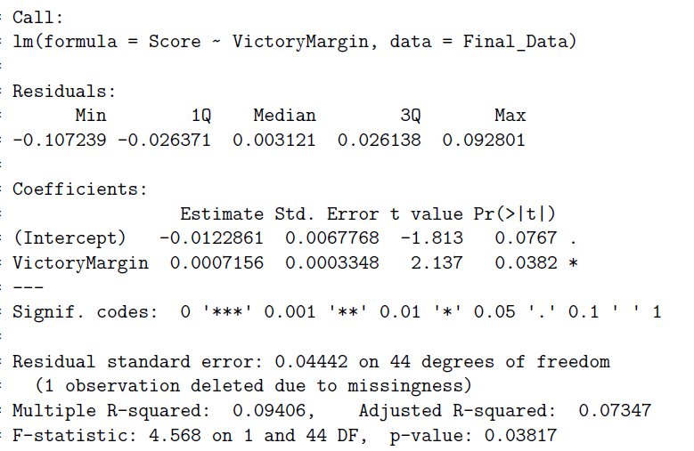
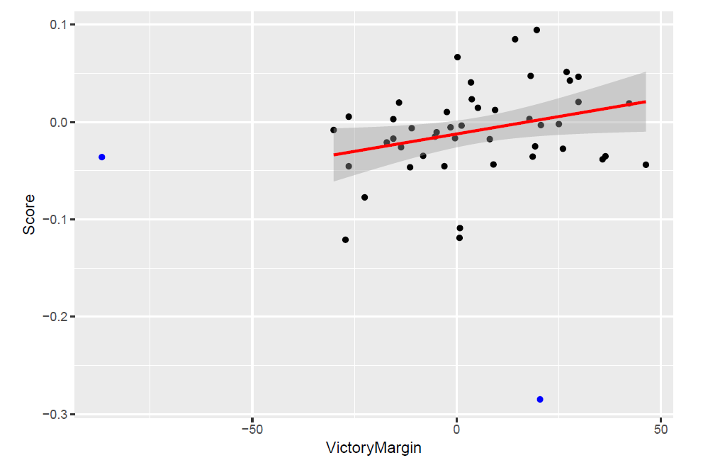
Regression Results
Roughly 9.4% of the variance found in the Sentiment Score can be explained by Victory Margin
P-value less than the alpha value .05 indicates that the relationship between Victory Margin and Sentiment Score is significant

Slide 15
Conclusion
State with highest resistance: Montana and State with highest support: Louisiana
Based on regression analysis, only 9.4% of the variation in Sentiment Score can be explained a linear relationship with the Victory Margin
A p-value less than .05 indicates that the null hypothesis can be rejected and can conclude that there is a significant linear relationship between Victory Margin and Sentiment Score
Tweets collected show that the sentiment towards President Trump has not changed much after the election

Slide 16
THANK YOU TO: CHRIS BISHOP SPRINGBOARD TEAM

Slide 17
References
https://extranewsfeed.com/what-does-twitter-have-to-say-about-trumps-executive-order-on-immigration-602f45eeef32

